Slide 1

OOSA&D(2018)
Decorating Objects: the Decorator Pattern

Slide 2
Review: The Observer Pattern
The Observer Pattern defines a one-to-many relationship between objects so that when one object changes state, all of its dependents are notified and updated automatically.

Slide 3
Glossary
decorator
runtime
responsibility
condiment
modification
Open-close principle
beverage
装饰者
运行时
职责
调味品
修改
开放封闭原则
饮料

Slide 4
Agenda
A Case Analysis
Design Pattern: The Decorator Pattern
In-class practice
An experiment in class
Practices of design pattern as homework
Dalian Neusoft University of Information © Copyright

Slide 5
Agenda
A Case Analysis
Design Pattern: The Decorator Pattern
In-class practice
An experiment in class
Practices of design pattern as homework
Dalian Neusoft University of Information © Copyright

Slide 6

Case: Starbuzz Coffee
Starbuzz coffee sells different beverages.
The cost of each beverage is calculated differently.
The beverages sold by Starbuzz are HouseBlend(混合咖啡), DarkRoast(炭烧）, Decaf(无咖啡因)and Espresso(浓咖啡).
Starbuzz needs a system to calculate the cost for each beverage when purchases are made.
Draw a class diagram for the system.

Slide 7
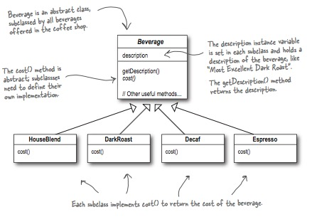
The Starbuzz Coffee example…
Notes:
decaf ['di:,kæf]
n. 无咖啡因咖啡；脱因咖啡（等于decaffeinated coffee

Slide 8


Starbuzz Coffee
Coffees
House Blend $0.89
Dark Roast $0.99
Decaf $1.05
Espresso $1.99
Condiments
Steamed Milk $0.10
Mocha $0.20
Soy $0.15
Whip $0.10
What if you want to show the addition of condiments such as steamed milk, soy, mocha and whipped milk?

Slide 9
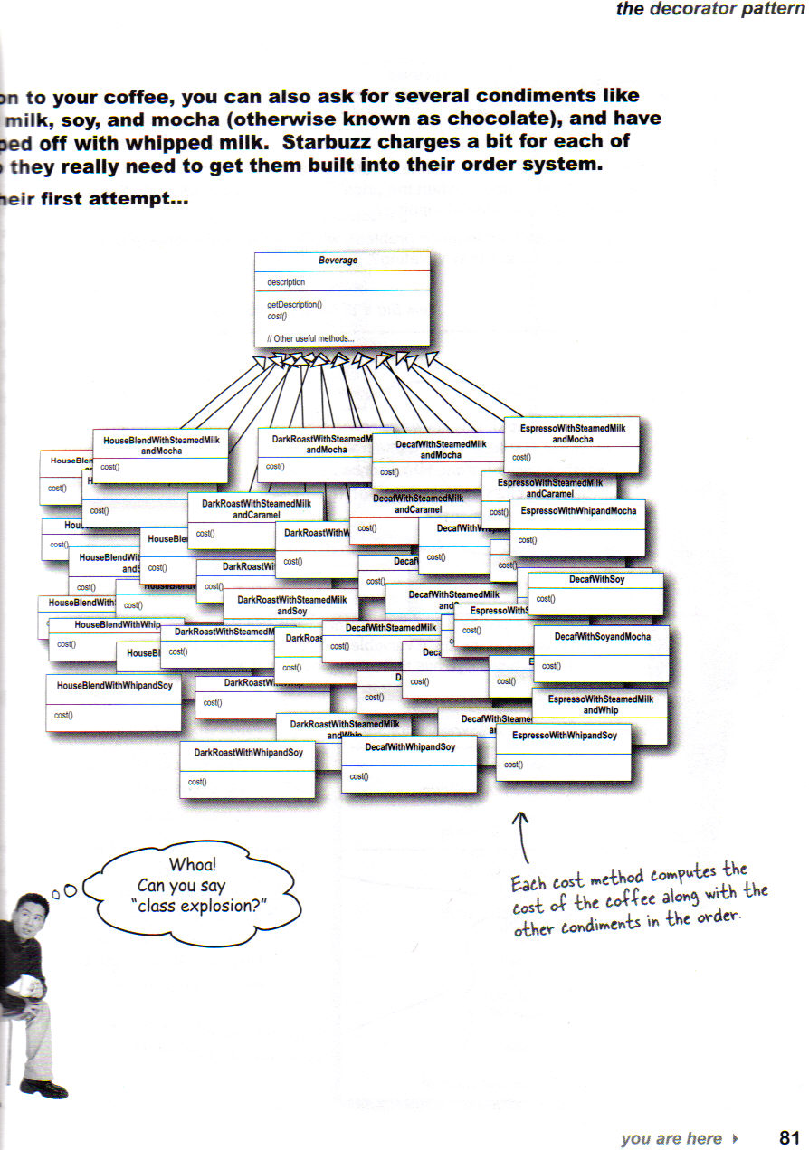
Page 81
Head First
Design Patterns

Slide 10
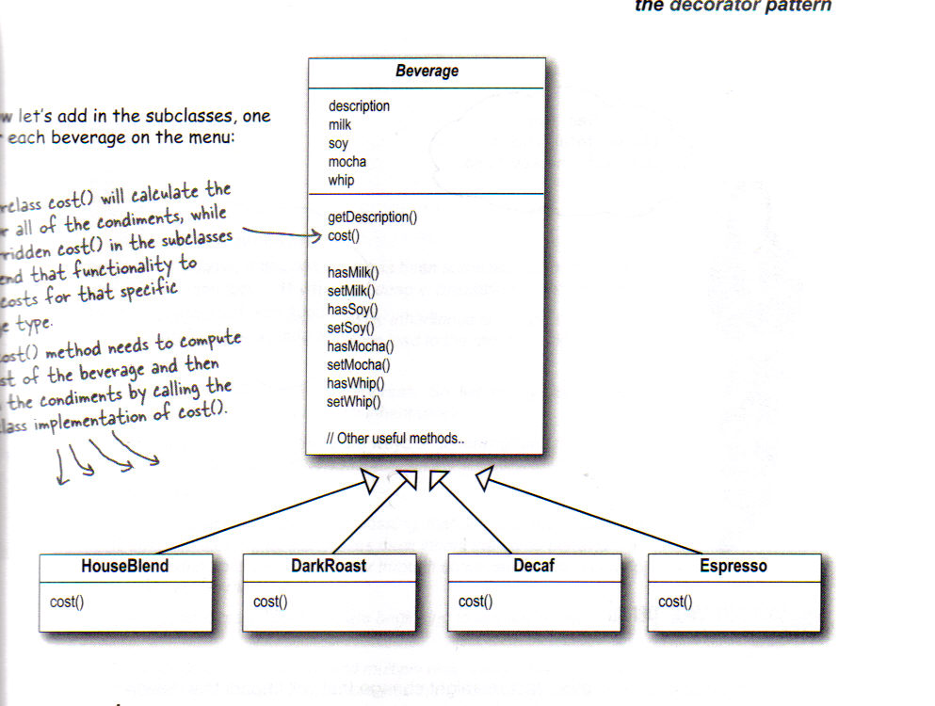
Beverage class redone
Page 83
Head First
Design Patterns

Slide 11
Potential problems with the design so far?
Solution is not easily extendable
How to deal with
new condiments
Price changes
New beverages that may have a different set of condiments – a smoothie?
Double helpings of condiments

Slide 12

Design Principle
The Open-Closed Principle
Classes should be open for extension, but closed for modification.

Slide 13
The Decorator Pattern
Take a coffee beverage object – say DarkRoast object
Decorate it with Mocha
Decorate it with Whip
Call the cost( ) method and rely on delegation to correctly compute the composite cost
Notes:
Mocha ['mɒkə]
n. 穆哈咖啡；穆哈（也门一港口）
adj. 用咖啡调味的；深咖啡色的

Slide 14
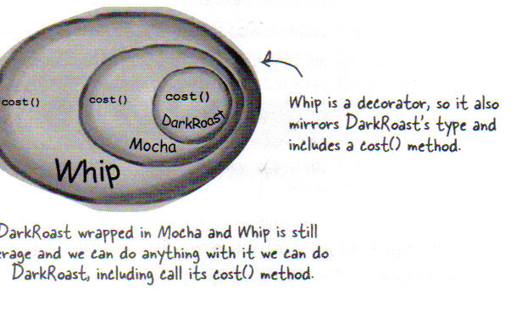
Decorator Pattern approach
Page 89
Head First
Design Patterns

Slide 15
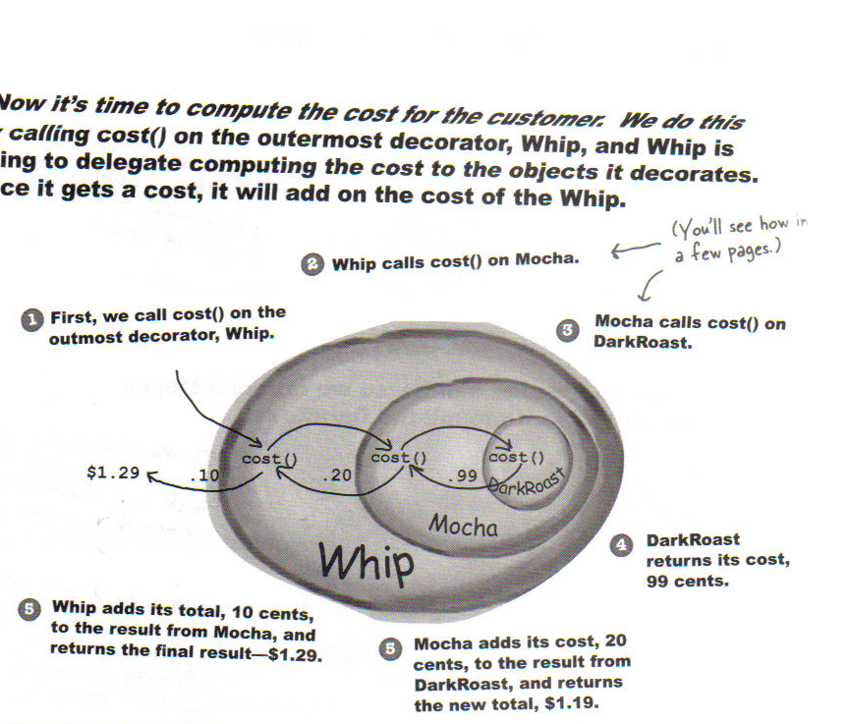
Computing Cost using the decorator pattern
Page 90
Head First
Design Patterns

Slide 16
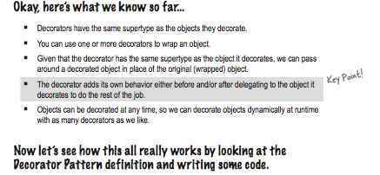
Computing Cost using the decorator pattern
Page 90
Head First
Design Patterns

Slide 17
The Decorator Pattern
The Decorator Pattern attaches additional responsibilities to an object dynamically. Decorators provide a flexible alternative to subclassing for extending functionality.

Slide 18
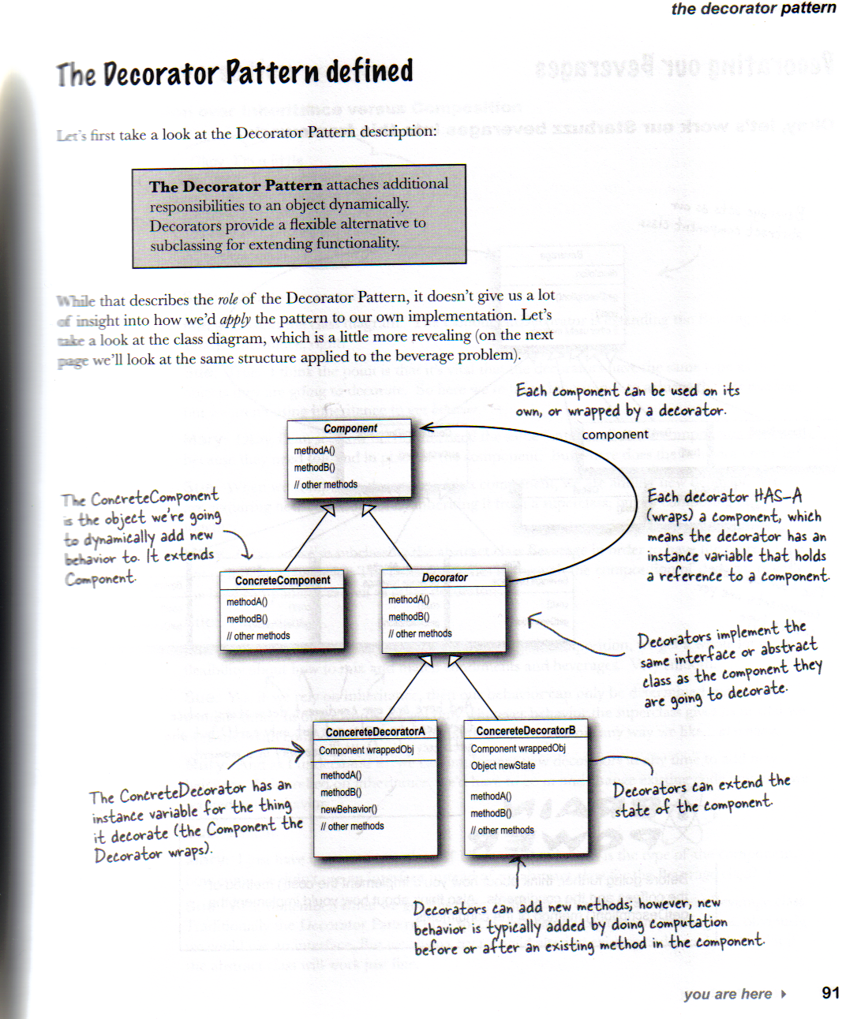
Decorator Pattern Defined
Decorator Pattern Defined
Page 91
Head First
Design Patterns

Slide 19
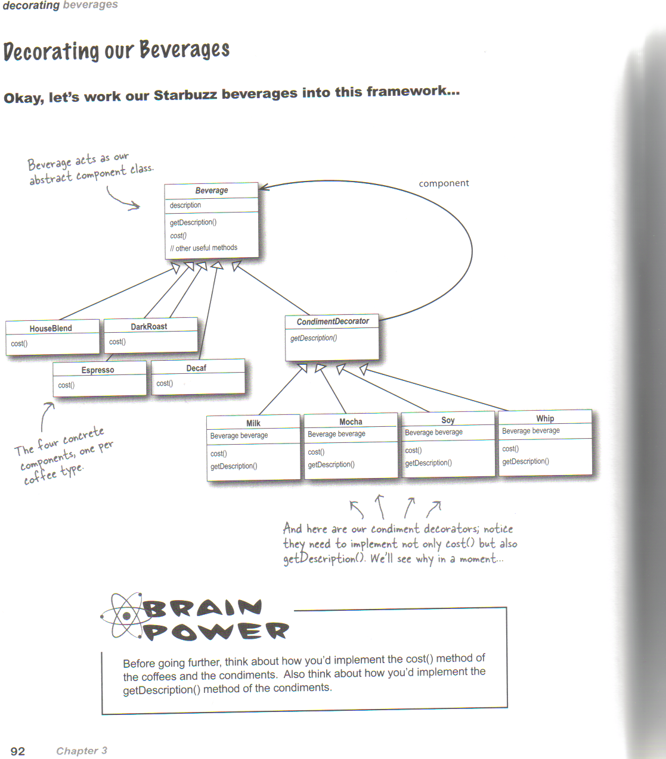
Decorator Pattern for Beverage Example
Page 92
Head First
Design Patterns

Slide 20
The Decorator Pattern
Intent
Attach additional responsibilities to an object dynamically（动态地）. Decorators provide a flexible alternative（选择） to subclassing for extending functionality.
Client-specified embellishment（装饰） of a core object by recursively（递归地） wrapping it.
Wrapping a gift, putting it in a box, and wrapping the box.

Slide 21
The Decorator Pattern
Problem
You want to add behavior or state to individual objects at run-time. Inheritance is not feasible because it is static and applies to an entire class.

Slide 22
Starbuzz code (P95)
public abstract class Beverage {
String description = "Unknown Beverage";
public String getDescription() {
return description;
}
public abstract double cost();
}

Slide 23
Decorator Class
public abstract class CondimentDecorator extends Beverage {
public abstract String getDescription();
}

Slide 24
Coding Bevarages
public class Espresso extends Beverage {
public Espresso() {
description = "Espresso";
}
public double cost() {
return 1.99;
}
}

Slide 25
Another beverage
public class DarkRoast extends Beverage {
public DarkRoast() {
description = "Dark Roast Coffee";
}
public double cost() {
return .99;
}
}

Slide 26
Coding Condiments
public class Mocha extends CondimentDecorator {
Beverage beverage;
public Mocha(Beverage beverage) {
this.beverage = beverage;
}
public String getDescription() {
return beverage.getDescription() + ", Mocha";
}
public double cost() {
return .20 + beverage.cost();
}
}

Slide 27
Serving some coffee – Espresso please
public class StarbuzzCoffee {
public static void main(String args[]) {
Beverage beverage = new Espresso();
System.out.println(beverage.getDescription()
+ " $" + beverage.cost());

Slide 28
How about a double mocha dark roast with whipped milk?
Beverage beverage2 = new DarkRoast();
beverage2 = new Mocha(beverage2);
beverage2 = new Mocha(beverage2);
beverage2 = new Whip(beverage2);
System.out.println(beverage2.getDescription()
+ " $" + beverage2.cost());

Slide 29
House blend with soy, mocha and whip, please
Beverage beverage3 = new HouseBlend();
beverage3 = new Soy(beverage3);
beverage3 = new Mocha(beverage3);
beverage3 = new Whip(beverage3);
System.out.println(beverage3.getDescription()
+ " $" + beverage3.cost());
}
}

Slide 30
Running the application
Espresso $1.99
Dark Roast Coffee, Mocha, Mocha, Whip $1.49
House Blend Coffee, Soy, Mocha, Whip $1.34

Slide 31
A look at Java GUI classes
Java I/O uses a lot of decorator pattern

Slide 32
Java I/O Use of Decorator Pattern
LineNumberInputStream
BufferedInputStream
FileInputStream

Slide 33
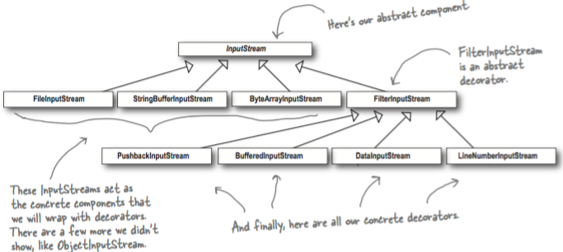
Decorating Java I/O Classes
Notes:
PushBackInputStream: 试探性读取，可回退。
BufferedInputStream：带缓冲，减少读取磁盘的次数。

Slide 34
Look at Java I/O classes(P100)
FilterInputStream
BufferedInputStream

Slide 35
public class LowerCaseInputStream extends FilterInputStream {
public LowerCaseInputStream(InputStream in) {
super(in);
}
public int read() throws IOException {
int c = super.read();
return (c == -1 ? c : Character.toLowerCase((char)c));
}
public int read(byte[] b, int offset, int len) throws IOException {
int result = super.read(b, offset, len);
for (int i = offset; i < offset+result; i++) {
b[i] = (byte)Character.toLowerCase((char)b[i]);
}
return result;
}
}

Slide 36
public class InputTest {
public static void main(String[] args) throws IOException {
int c;
try {
InputStream in =
new LowerCaseInputStream(
new BufferedInputStream(
new FileInputStream("test.txt")));
while((c = in.read()) >= 0) {
System.out.print((char)c);
}
in.close();
} catch (IOException e) {
e.printStackTrace();
}
}
}

Slide 37
Summary so far..(P105)
OO Basics
Abstraction
Encapsulation
Inheritance
Polymorphism
OO Principles
Encapsulate what varies
Favor composition over inheritance
Program to interfaces not to implementations
Strive for loosely coupled designs between objects that interact
Classes should be open for extension but closed for modification.

Slide 38
Checkpoints (1/2)
Inheritance is one form of extension, but not necessarily the best way to achieve flexibility in our designs.
In our designs we should allow behavior to be extended without the need to modify existing code.
Composition and delegation can often be used to add new behaviors at runtime.
The Decorator Pattern provides an alternative to subclassing for extending behavior.

Slide 39
Checkpoints(2/2)
Decorators change the behavior of their components by adding new functionality before and/or after (or even in place of) method calls to the component.
You can wrap a component with any number of decorators.
Decorators are typically transparent to the client of the component; that is, unless the client is relying on the component’s concrete type.

Slide 40
Agenda
A Case Analysis
Design Pattern: The Decorator Pattern
An Application for example
An experiment in class
Practices of design pattern as homework
Dalian Neusoft University of Information © Copyright

Slide 41
3. An Application for example
A transformer is a car before it transforms. It could move on land. When it becomes a robot, it can also speak except for being able to move on land. If it is necessary, it can also become an airplane. Besides moving on land, it can also fly in the sky.
Your job is to…
Design the class diagram
program according to your class diagram
Test your design.
Dalian Neusoft University of Information © Copyright

Slide 42
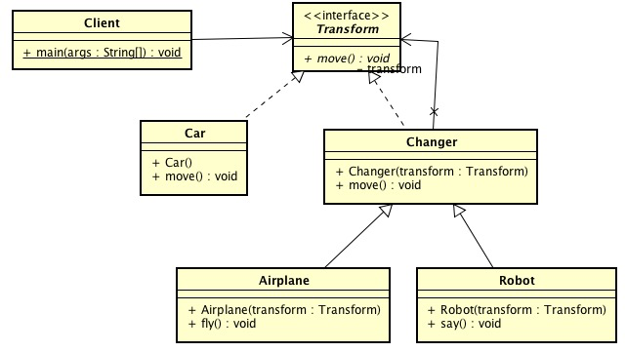
3. An Application for example
A transformer
Class Diagram

Slide 43

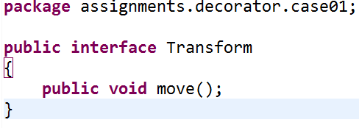
3. An Application for example

Slide 44
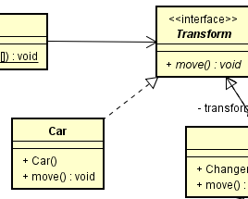
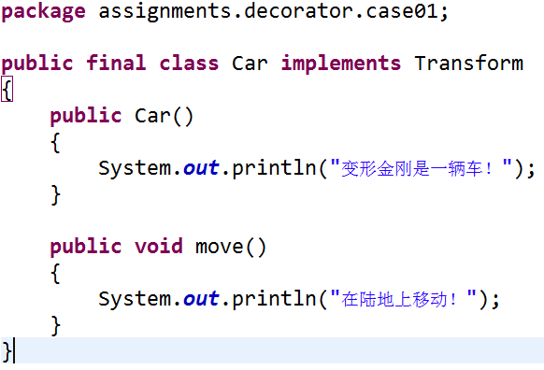
3. An Application for example

Slide 45
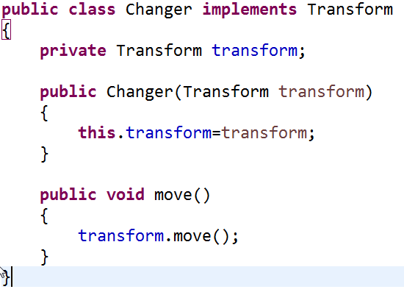
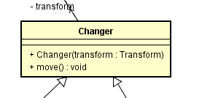
3. An Application for example

Slide 46
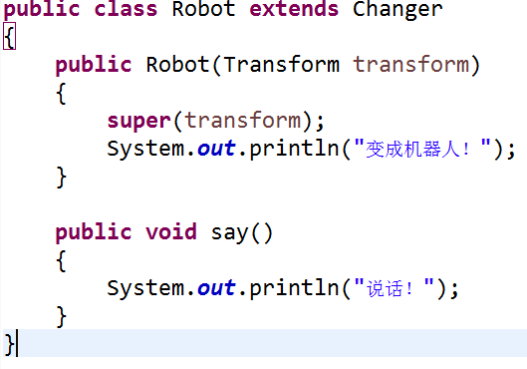
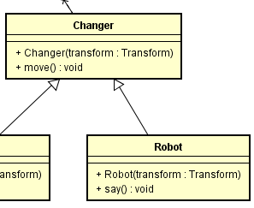
3. An Application for example

Slide 47
An experiment in class
Consider a window in a windowing system. To allow scrolling of the window's contents, one may wish to add horizontal or vertical scrollbars to it, as appropriate. Assume windows are represented by instances of the Window class, and assume this class has no functionality for adding scrollbars. One could create a subclass ScrollingWindow that provides them, or create a ScrollingWindowDecorator that adds this functionality to existing Window objects.
Your job is to…
Design the class diagram
program according to your class diagram
Test your design.
Dalian Neusoft University of Information © Copyright

Slide 48
Homework
Finish the homework, which includes 3 tasks.
Dalian Neusoft University of Information © Copyright

